Slide 1
SEVENTY-NINTH INTERNATIONAL
ATLANTIC ECONOMIC CONFERENCE
INVITED ADDRESS
LUIGI ZINGALES
CHICAGO BOOTH SCHOOL OF BUSINESS
“Diagnosing the Italian Disease”
MILAN 11-14 MARCH 2015

Slide 2
Diagnosing the Italian Disease
December 2014
Bruno Pellegrino
University of California
Luigi Zingales
University of Chicago

Slide 3
GDP per Hour Worked (2005 PPP$)

Slide 4
Motivation
Twenty years ago Italy’s labor productivity stopped growing.
Understanding why is important for several reasons:
Italy is the sick country of Europe. Difficult for the euro to survive without Italy improving
The Italian disease is a more acute form of a European disease-> understand better link between institutions and growth

Slide 5
Sector Level Data
EU-KLEMS structural database,
  value added, output, inputs, total factor productivity, and input compensation shares
at the 3-digit ISIC level for 25 European countries, Australia, South Korea, Japan, and the United States for the period 1970-2012.
We stop at 2007 to cut out the crisis
Lose 11 countries for lack of capital formation series
3 for inconsistent data
Down to 15 countries

Slide 6
Growth in GDP / Capita (1994–2006)

Slide 7
Sectors
We aggregate sectors 50 to 52 (wholesale and retail trade) to merge some explanatory variables in the dataset that are available at industry-level.
We use the aggregate sector 70t74 instead of 70 (real estate) and 71t74 (other business services) for problems in the attribution of real estate assets
We drop, as customary, public sector and social services (sectors 75-99)
Left with 23 sectors

Slide 9
Firm Level Data
EFIGE (European Firms in a Global Environment), developed by Altomonte and Aquilante (2012) for the think-tank Bruegel.
It contains balance sheet data for over 14,000 firms from 6 European countries (Austria, France, Germany, Hungary, Italy, Spain, UK).
EFIGE has a short time span and does not allow us to study the dynamics of productivity growth.
Yet, it allows us to observe key features of the businesses’ organizational model more directly.

Slide 10
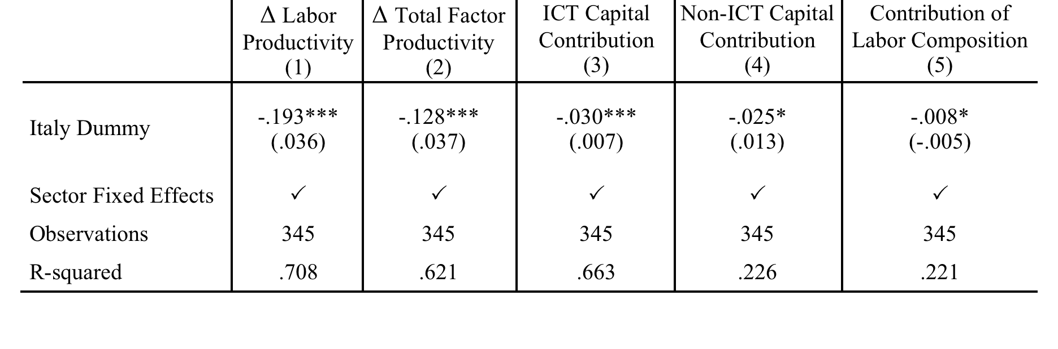
Italy’s productivity growth gap

Slide 11
Explanations Based on Traditional Italian Characteristics
“Bad” firm demographic
  “Wrong” sectors and too small a size
Lack of labor flexibility
Government inefficiency
Quality of human capital

Slide 12
Size and Sectors

Slide 13
Lack of Labor Flexibility

Slide 14
Need for Labor Flexibility

Slide 15
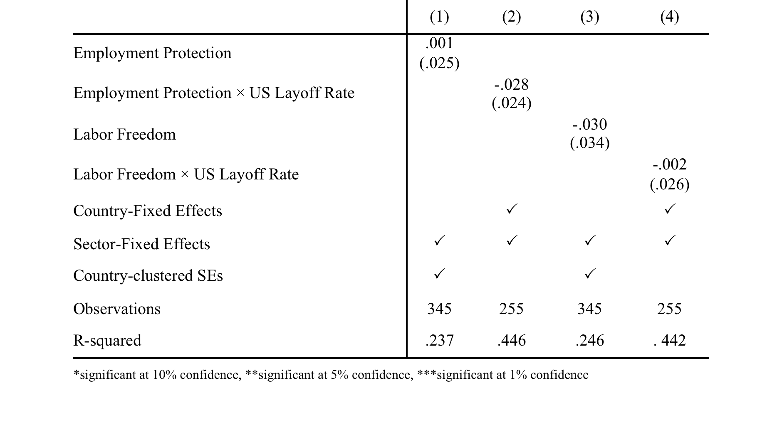
Table 5. TFP growth and Labor Market Regulation

Slide 16
Government Inefficiency

Slide 17
Impact of PA on a Sector
For the period 2000-2007 we count all news regarding a sector in Reuters, Thomson, Bloomberg, FT, WSJ, and Dow Jones (Factiva tag).
We re-compute from the same sources the news regarding the sector having government as topic.
We take the ratio of the two

Slide 18
Public Sector Dependence Scores (Factiva)

Slide 19
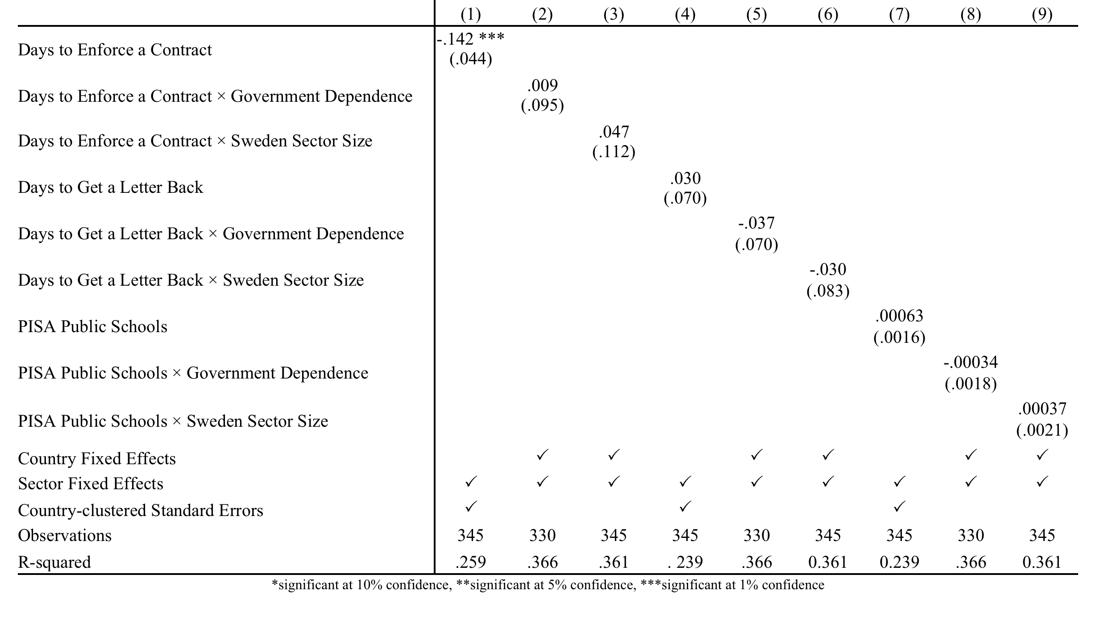
Table 6. TFP growth and public sector performance

Slide 20
TFP Growth and Human Capital Growth

Slide 21
Trade-Based Explanations
In the short term, a decrease in external demand for Italian products can adversely affect productivity through several channels
  Scale effect
  Embedded technological progress
  Impact on profitability
  Labor adjustment costs
In the long term, if there is a permanent drop in demand for Italian products, firms will eventually adjust or close.
  If they adjust, they will be forced to increase productivity.
  If they close, the least productive firms will close first, increasing the average productivity simply through a compositional effect.

Slide 22
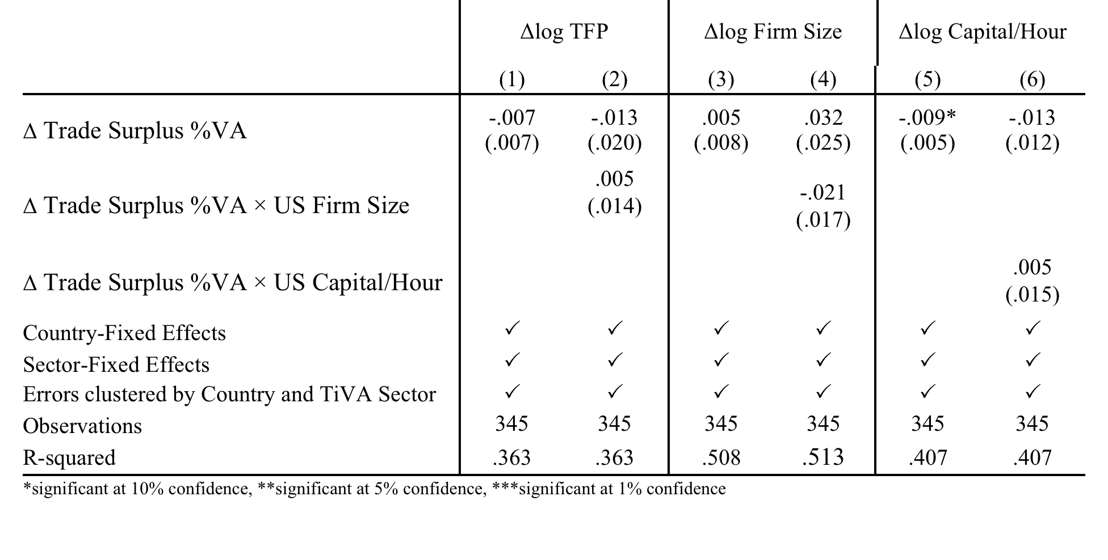
Table 8. Capital Accumulation, Firm Size Growth and the Trade Balance

Slide 23
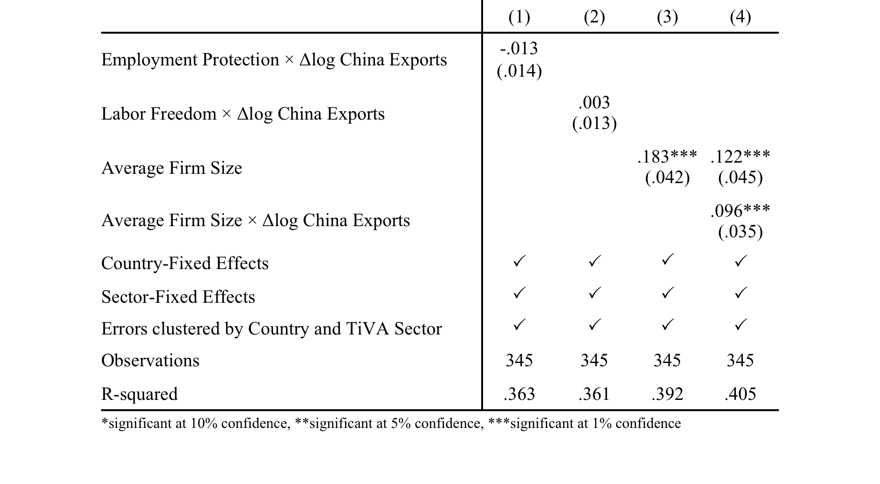
Table 9. Productivity growth, Employment Protection, Firm Size and China

Slide 24
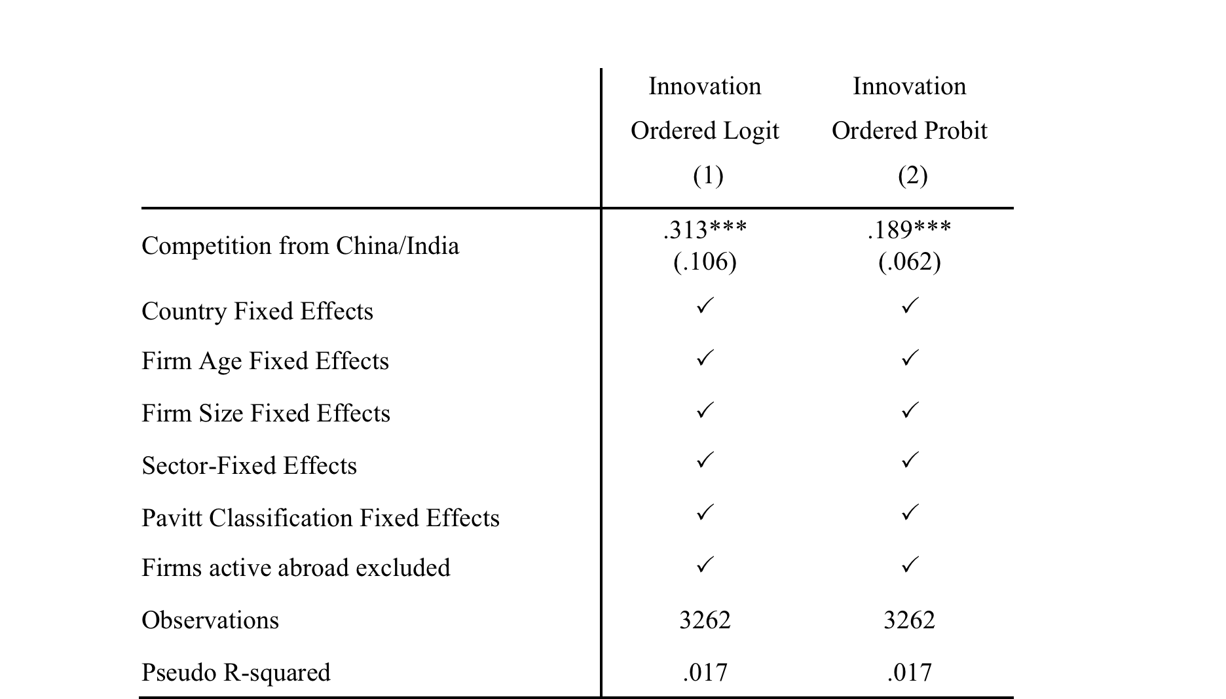
Table 10. Innovation and Foreign Competition

Slide 25
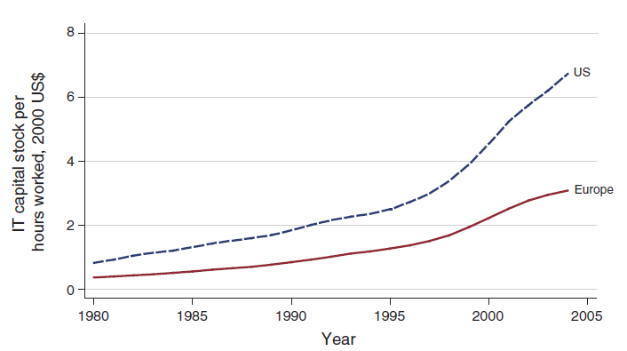
Figure 5. The ICT Revolution

Slide 26
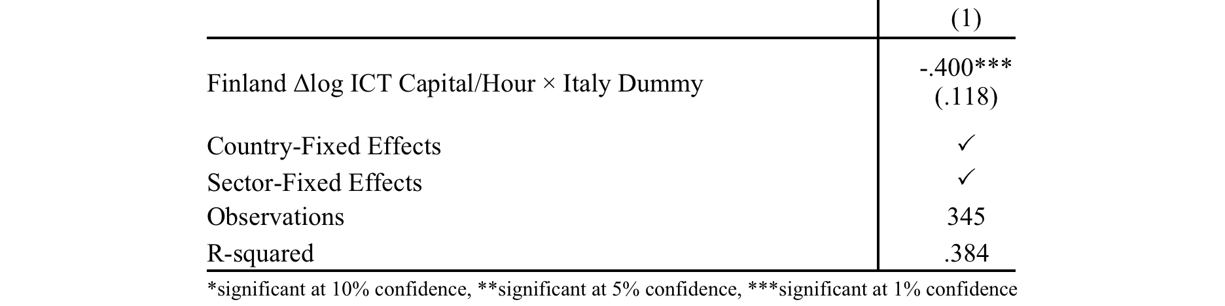
Table 11. Productivity growth and ICT capital growth

Slide 27
Ability to Exploit IT Revolution
Bloom et al. (2012) productivity gap between US and EU due to a combination of IT and management.
Bresnahan et al (2002): complementarities between IT and workplace reorganization.
Institutional factors (size, organization, low labor flexibility, large black market economy) may have prevented Italy from taking full advantage of the ICT revolution.

Slide 28
Networked Readiness Index
World Economic Forum measures “Networked Readiness”:
Networked Readiness Index =
1/4 Environment subindex
+ 1/4 Readiness subindex
+ 1/4 Usage subindex
+ 1/4 Impact subindex

Slide 29
Networked Readiness

Slide 30
ICT Contribution to Growth, by Sector

Slide 31
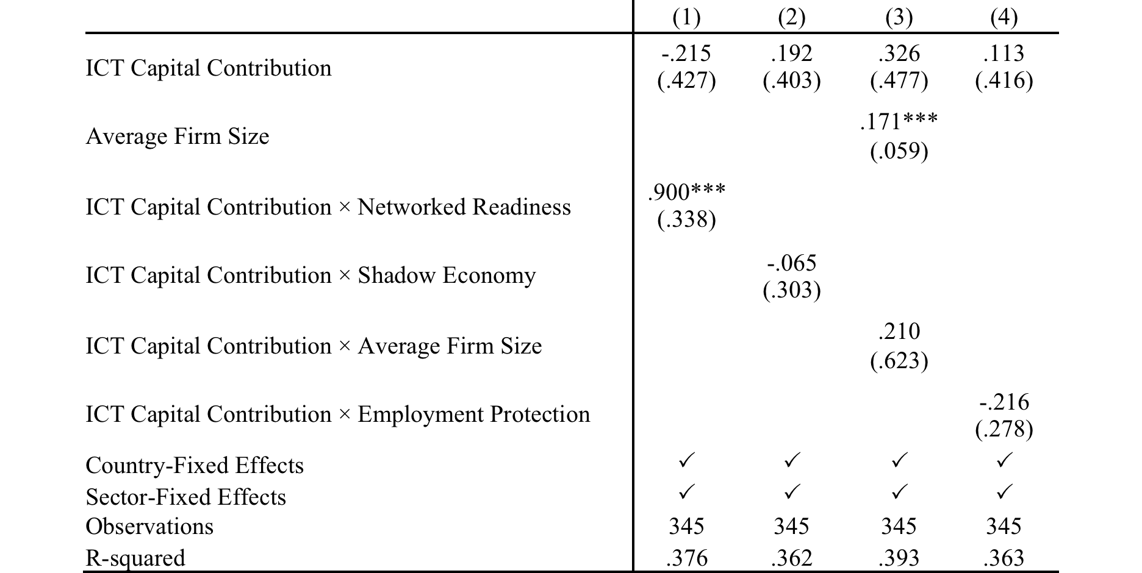
Table 12. Productivity growth, ICT capital and Networked Readiness

Slide 32
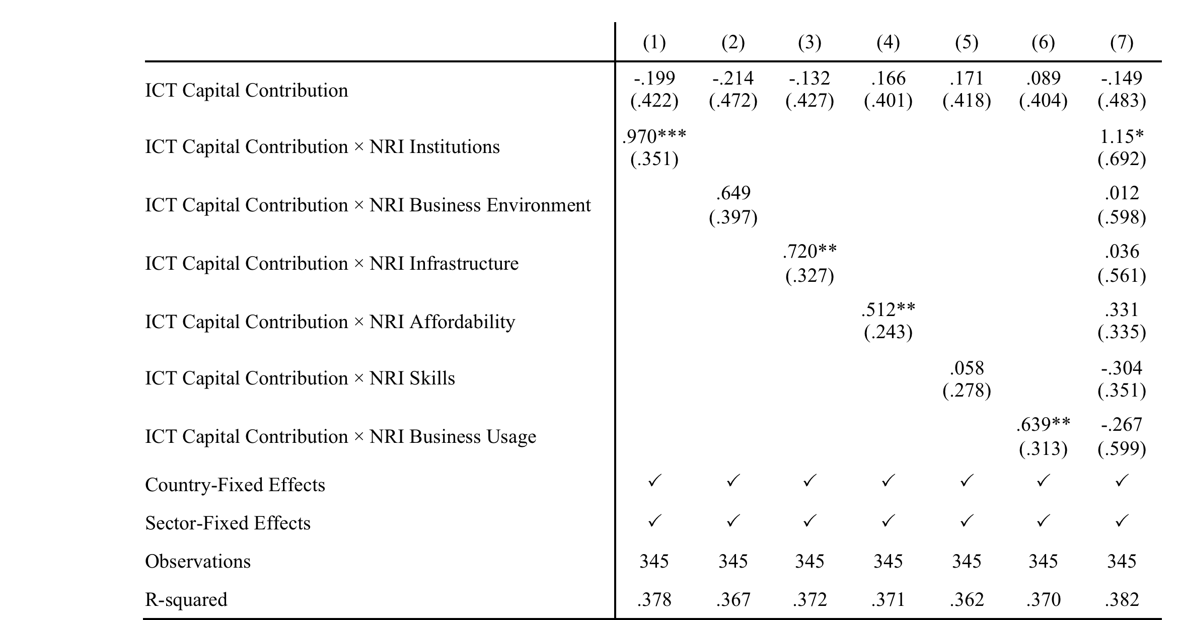
Table 13. Productivity growth, ICT capital, and Networked Readiness

Slide 33
What is Network Readiness?
Quality of managers?
  Quality of management schools
  Number of GMAT takes /population
Meritocratic selection:
perceived favoritism in officials’ decision making.
the degree of meritocracy in the selection of private sector managers.
We average these two variables to form a proxy for meritocracy

Slide 34
Meritocracy

Slide 35
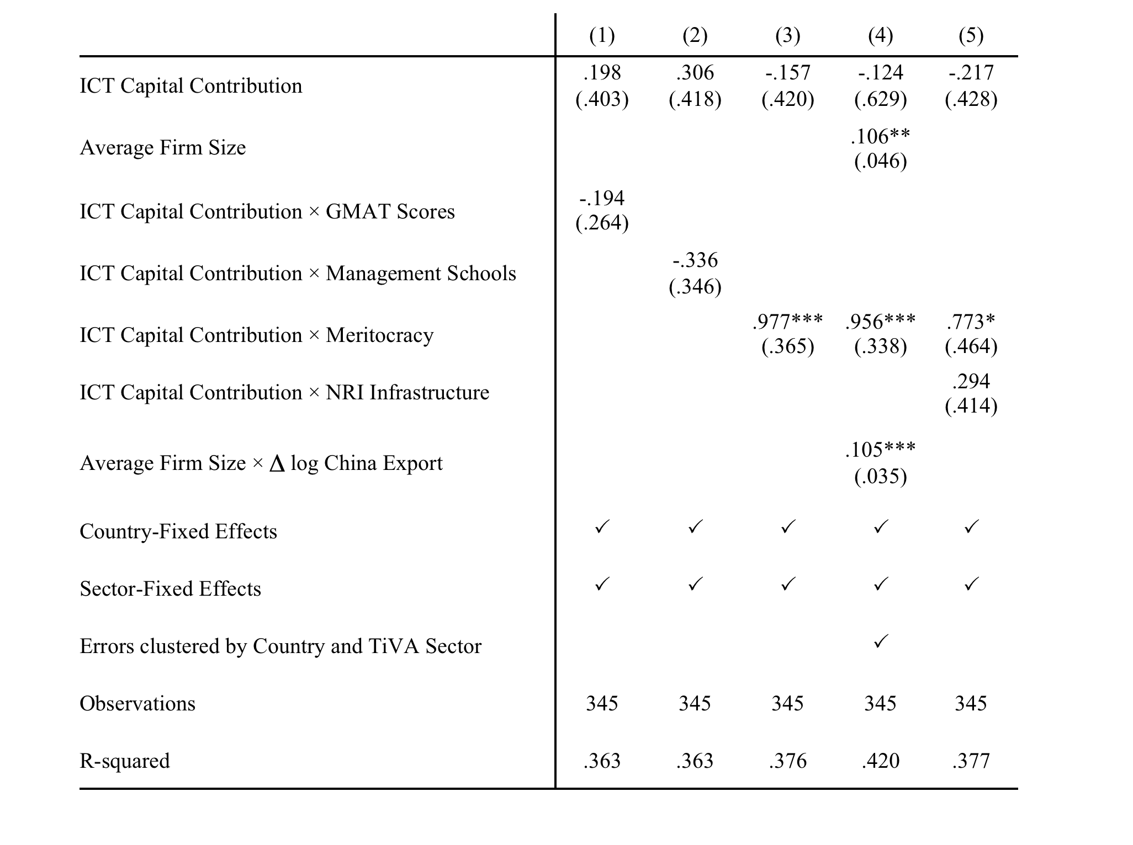
Table 14. Productivity growth, ICT capital accumulation and Management

Slide 36
ICT and productivity
The impact of ICT on productivity is crucially mediated by management
As Garicano and Heaton (2010) show enjoying the benefits of technology requires
  Measurable goals
  Internal accountability
  Middle management empowerment
  Rewards
=> performance-based, meritocratic management

Slide 37

Compstat
  Introduced by the New York Police Department in 1994 by Commissioner William Bratton.
  the real time mapping of crime by time and place
  (notorious) early morning meetings
  Weisburd:
  statement of the measurable goals of the department;
  internal accountability, particulary through Compstat meetings
  geographic organization of command-- district commanders have authority and resources to accomplish their goals over their areas;
  empowerment of middle managers;
  data driven problem identification and assessment;
  (6) innovative problem solving tactics.

Slide 38
Firm-Level IT usage
To quantify a firm’s level of IT usage, we count the number of “yes” answers to the following questions:
  Does the firm have access to a broadband connection (high-speed transmission of digital content)?
  Does the firm use IT systems/solutions for internal information management (e.g. SAP / CMS)?
  Does the firm use IT systems/solutions for E-commerce (e.g. SAP / CMS)?
  Does the firm use IT systems/solutions for management of the sales/purchase network?

Slide 39
Firm-Level Performance Manag.
Mimicking Bandiera et al (2008) we extract the first principal component from the following six dummy variables:
  the firm’s CEO belongs to the controlling family (-)
  the firm is family-managed (-)
  management is de-centralized (+)
  the firm uses bonuses to incentivize managers (+)
  the firm has sought a third-party quality certif. (+)
  at least one of the firm’s executives has worked more than one year abroad (+)

Slide 40
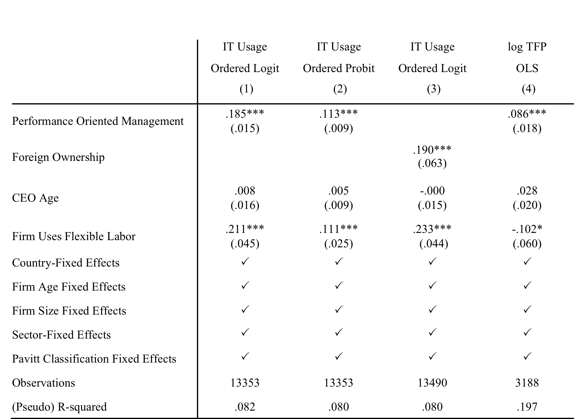
Table 15. IT usage and Management Models

Slide 41
Institutions and Incentives

Slide 42
Conclusions
The Italian disease appears to be an extreme form of a European disease:
  inability to take full advantage of the ICT revolution
This disease appears to be linked to the lack of meritocracy and professional performance-based management.
We still need to explain why these practices are so rare in Italy and Southern Europe.

Slide 43
Conclusions - 2
Suppose that there is some institutional factor in Southern Europe that makes difficult to keep up with technological change.
Difficult to keep up with a fixed exchange rate.
How could have Japan and the United States kept a fixed exchange rate from 1950 to 1990?
Organizational issues are crucial for the survival of the euro.

